Slide 1
2025 OFFICE DESIGN TRENDS REPORT

Slide 2
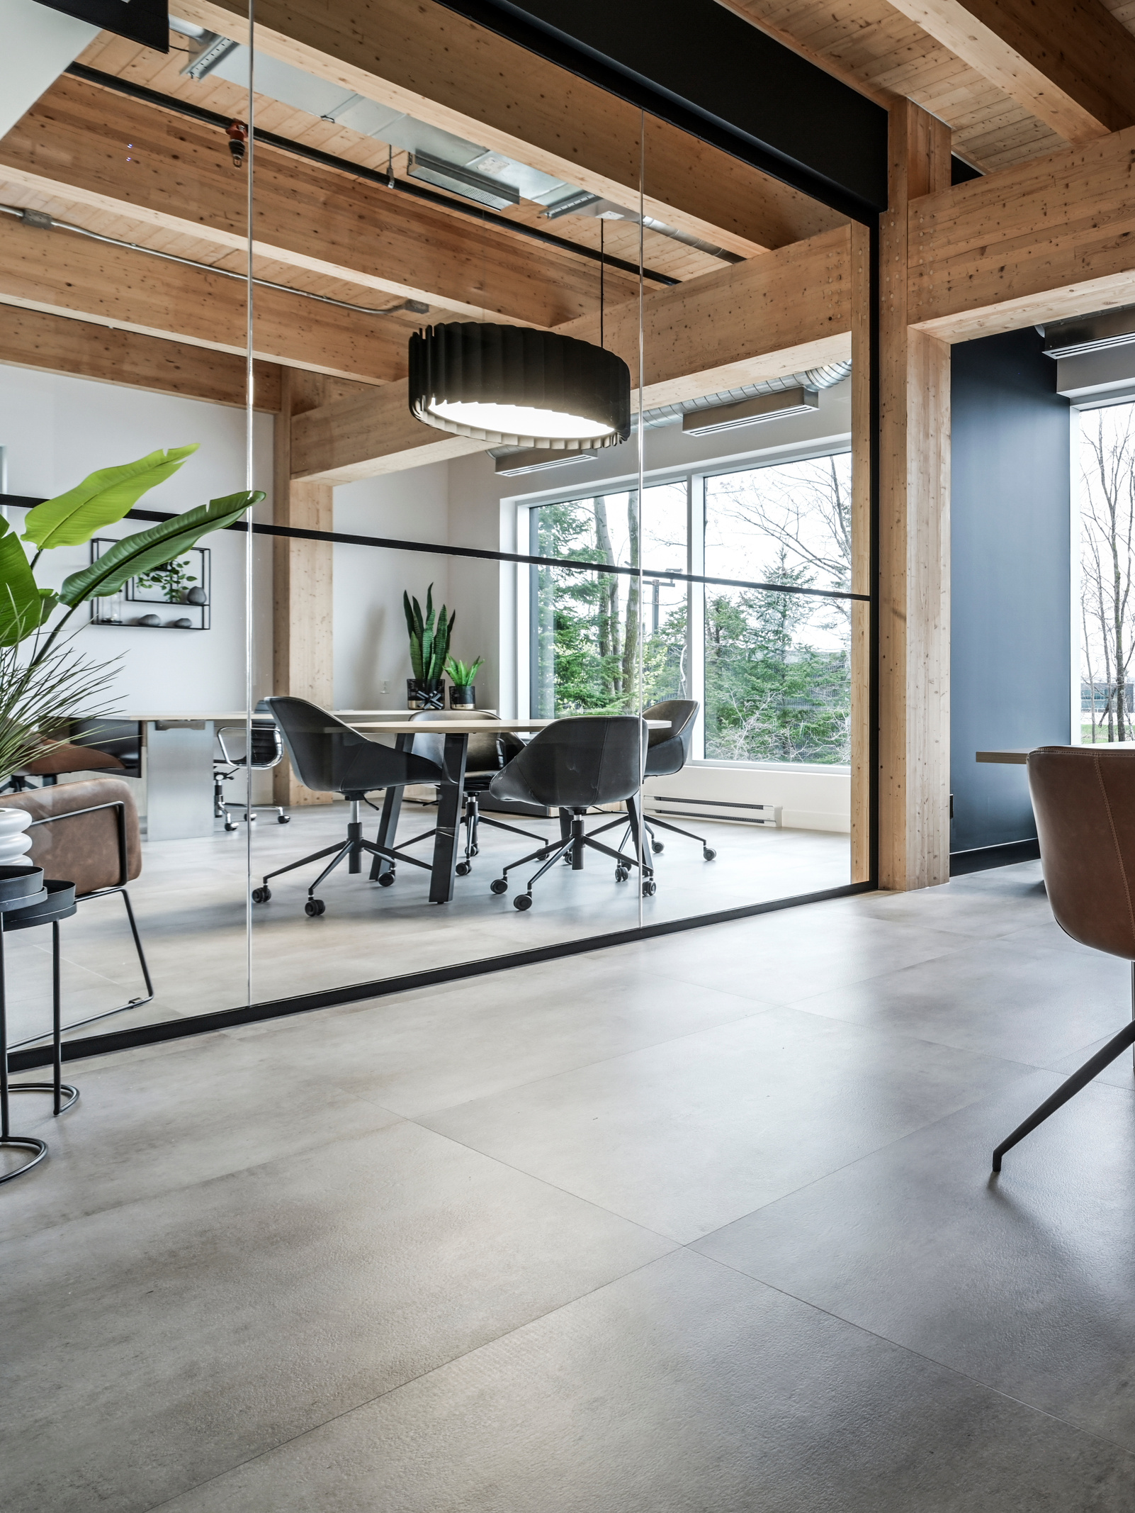
INTRODUCTION
As 2024 comes to a close, businesses are looking to the future of workplace design, seeking innovative strategies to attract talent, boost productivity, and align with environmental and technological advancements.
The 2025 Office Design Trends Report outlines the key developments set to shape modern workspaces, helping companies adapt to a rapidly evolving professional landscape.

Slide 3
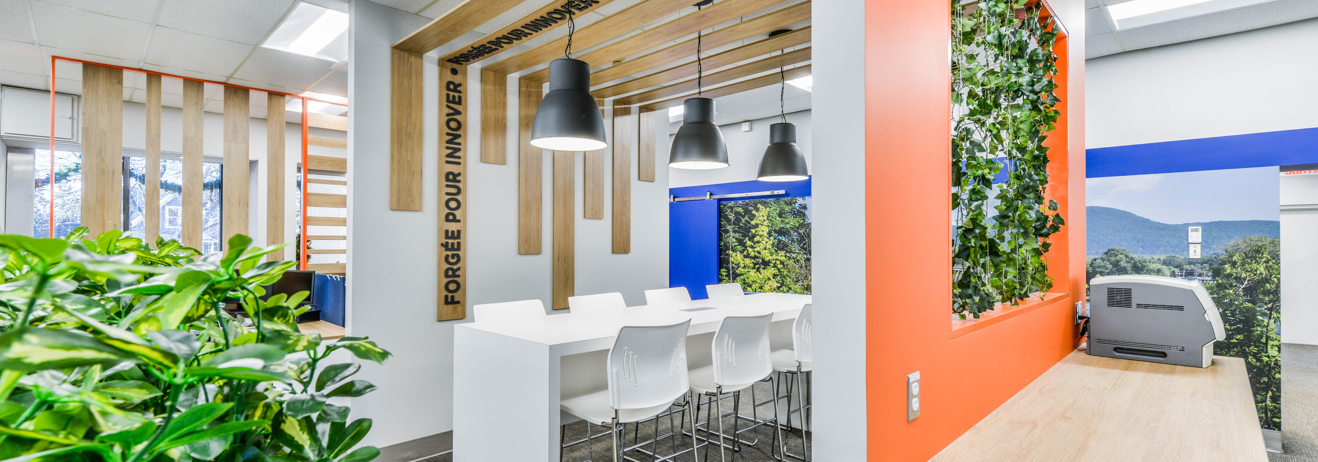
BIOPHILIC DESIGN 2.0: NATURE-DRIVEN INNOVATION
Biophilic design continues to evolve, incorporating not just natural elements but advanced technologies. Offices in 2025 will feature AI-controlled lighting systems that mimic natural daylight cycles, vertical gardens enhanced by automated irrigation, and sensory experiences using soundscapes or aromatherapy to reduce stress.
Key Benefits:
Increased employee well-being and productivity
Enhanced air quality and noise reduction
Positive impacts on mental health

Slide 4
BIOPHILIC DESIGN CAN ENHANCE PRODUCTIVITY BY 15% AND REDUCE STRESS BY 37%, ACCORDING TO THE INTERNATIONAL WELL BUILDING INSTITUTE.

Slide 5
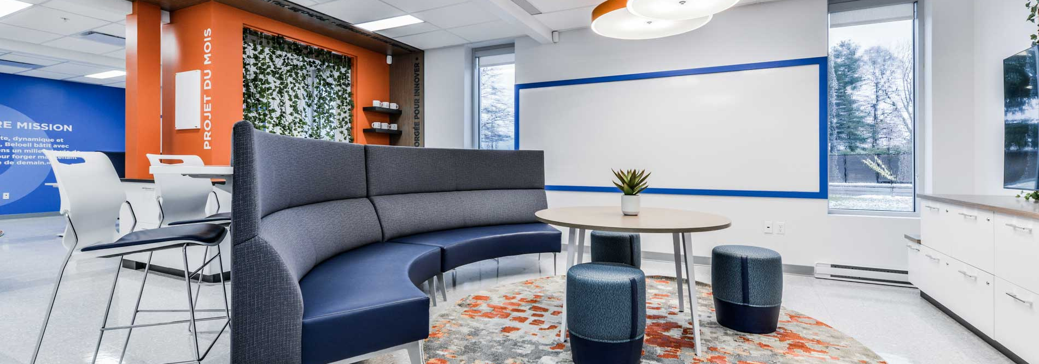
FLEXIBILITY & MODULARITY: ADAPTING TO HYBRID WORKFORCES
The hybrid work model demands adaptable office layouts. Modular furniture and multi-purpose spaces will allow businesses to reconfigure areas for collaboration, focus, or relaxation as needed. Work pods, movable walls, and shared desks will be staples of the 2025 office.
Key Benefits:
Cost savings through versatile space usage
Improved collaboration for on-site teams
Support for remote and hybrid workers

Slide 6
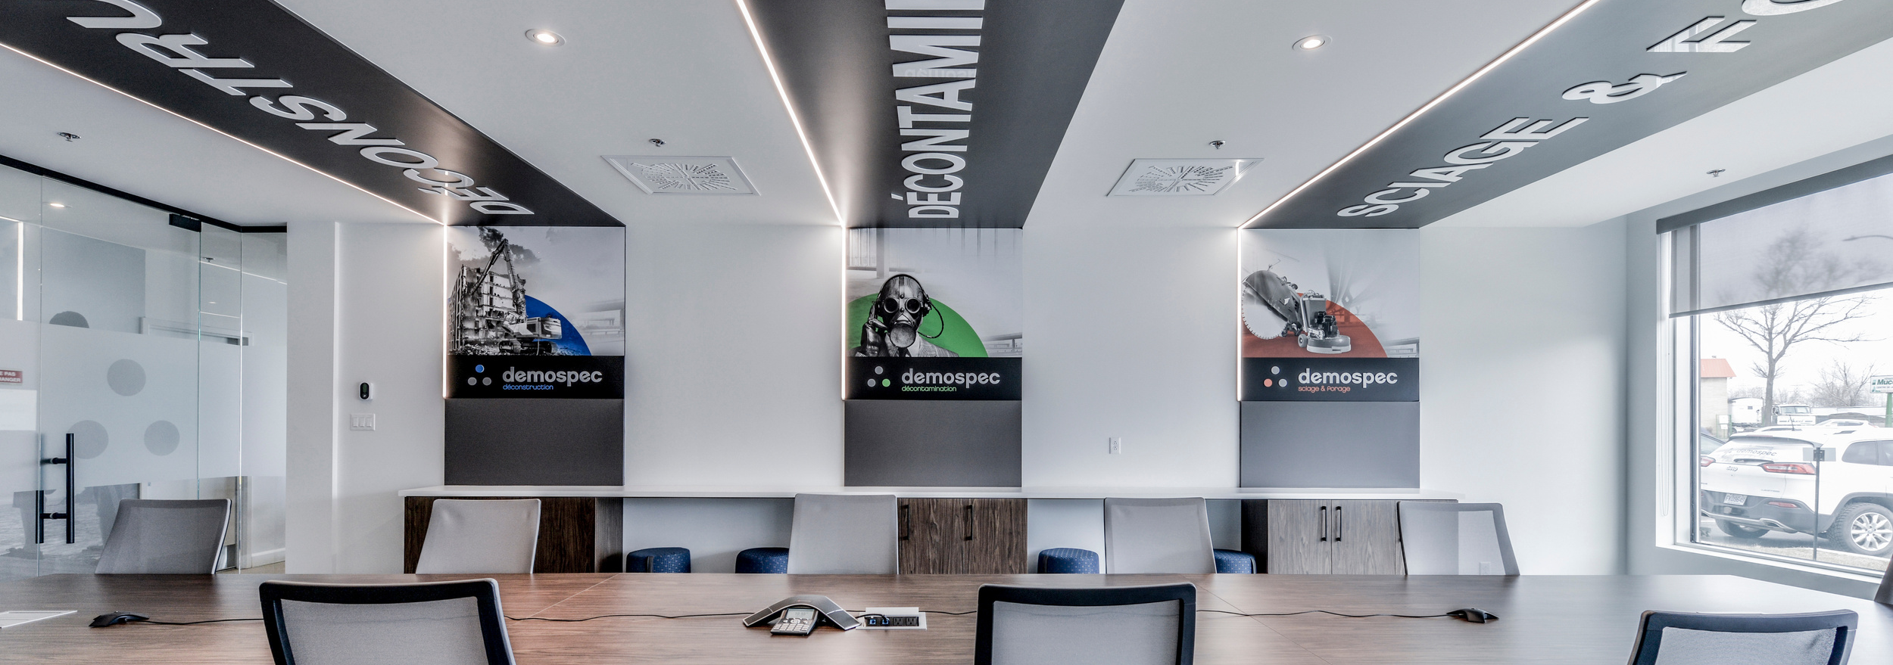
TECH-INTEGRATED WORKSPACES: THE SMART OFFICE REVOLUTION
Smart technologies will dominate workplace design, integrating Internet of Things (IoT) solutions for seamless operations. This includes automated desks that adjust to user preferences, occupancy sensors to optimize space usage, and AR/VR tools for remote collaboration.
Key Benefits:
Enhanced efficiency
Improved collaboration
Personalized work experience

Slide 7
A GARTNER RESEARCH STUDY HIGHLIGHTS THAT 85% OF EMPLOYEES PREFER WORKPLACES WITH INTEGRATED SMART TECHNOLOGIES.

Slide 8
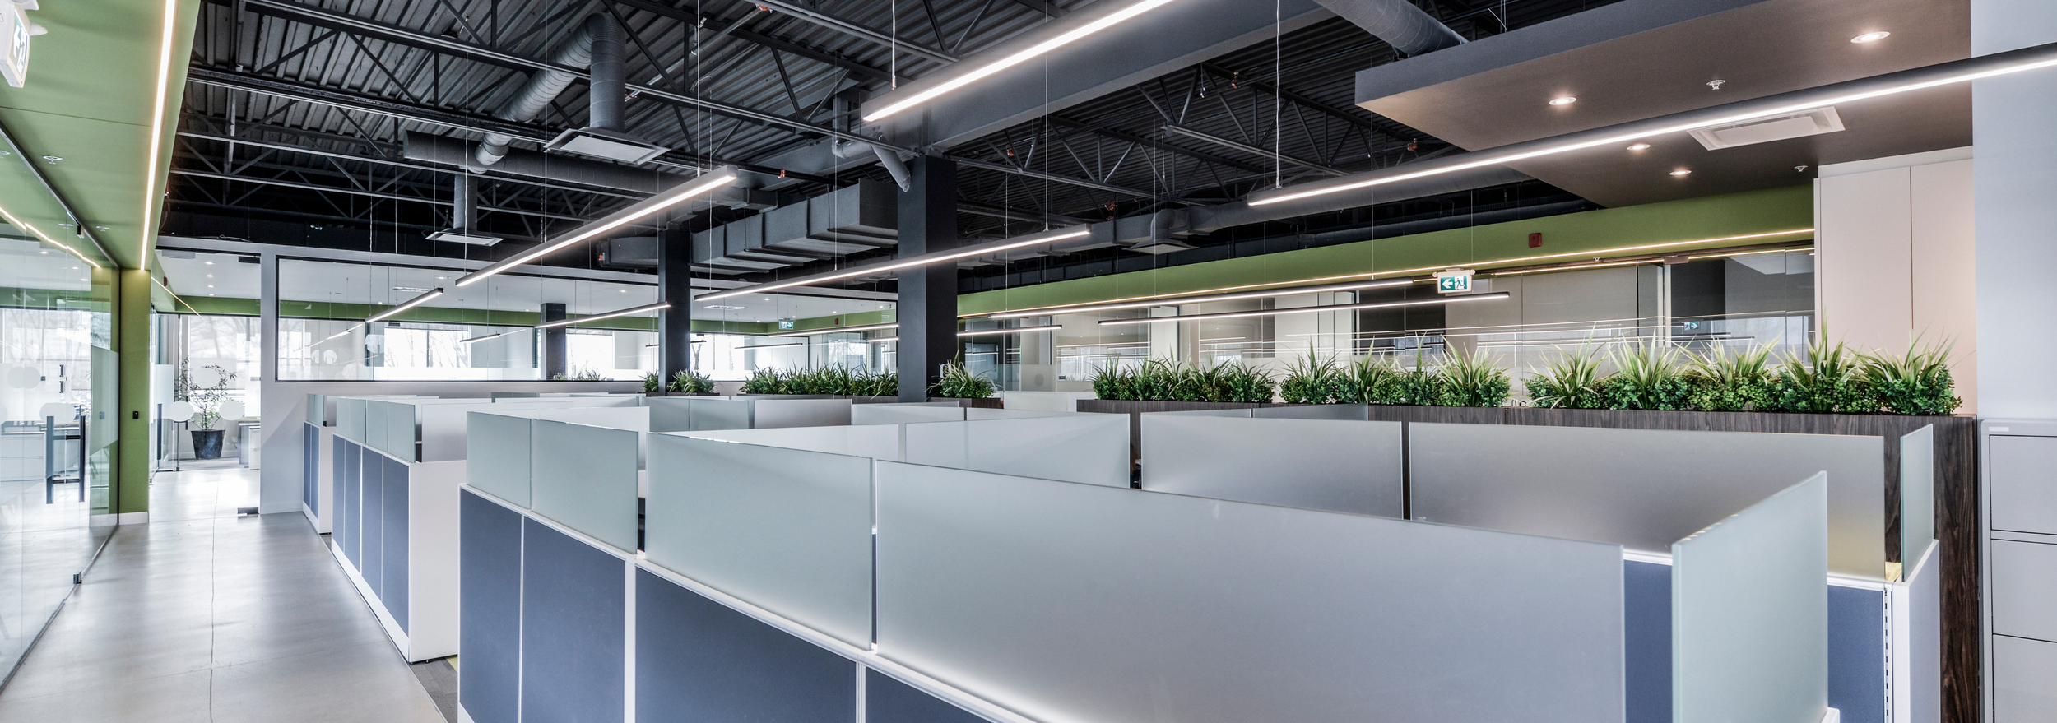
SUSTAINABILITY & NET-ZERO WORKSPACES: DESIGNING FOR THE PLANET
Sustainability will remain a top priority with businesses striving to meet net-zero goals. Expect offices to use recycled and upcycled materials, energy-efficient appliances, and renewable energy sources. Certifications like LEED and WELL will become benchmarks for office design.
Key Features:
Solar panels and wind energy systems
Low-carbon materials such as bamboo and cork
Water-saving technologies in plumbing fixtures

Slide 9
DEMAND FOR SUSTAINABLE MATERIALS IN OFFICE DESIGN IS PROJECTED TO GROW BY 25% BY 2025, ACCORDING TO THE GREEN BUILDING COUNCIL.

Slide 10
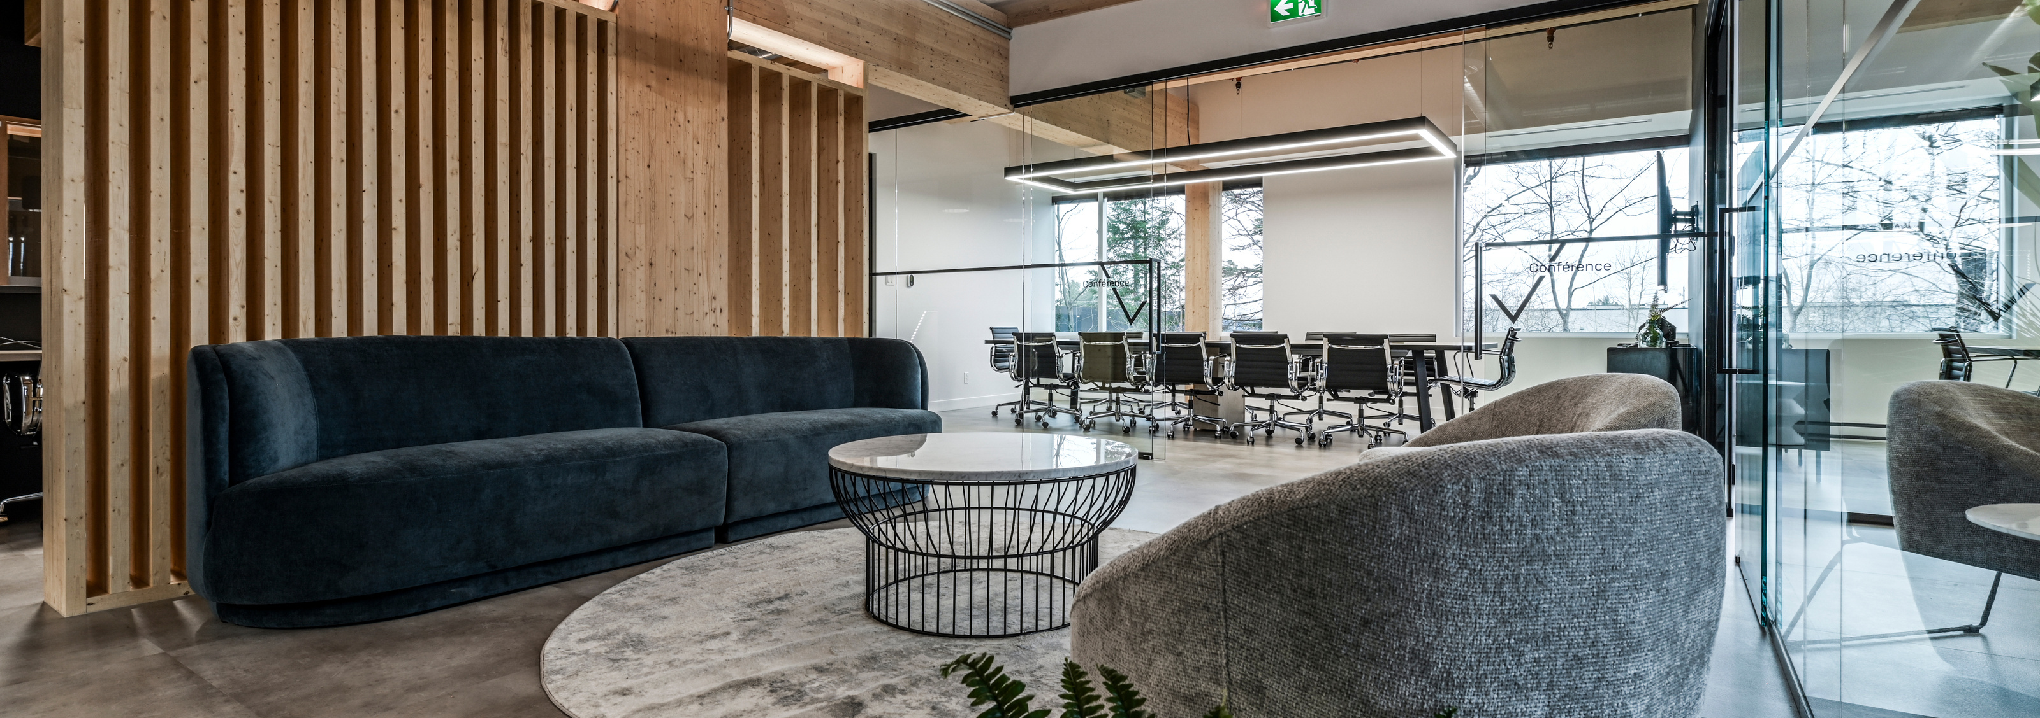
WELLNESS-CENTRIC ENVIRONMENTS: PRIORITIZING EMPLOYEE HEALTH
Employee well-being will take center stage in office design, with features like sound-masking systems, ergonomic furniture, and dedicated wellness zones. Offices will also include mental health support spaces, such as quiet rooms or meditation areas.
Key Benefits:
Reduced absenteeism and burnout
Enhanced focus and morale
Attraction and retention of top talent

Slide 11
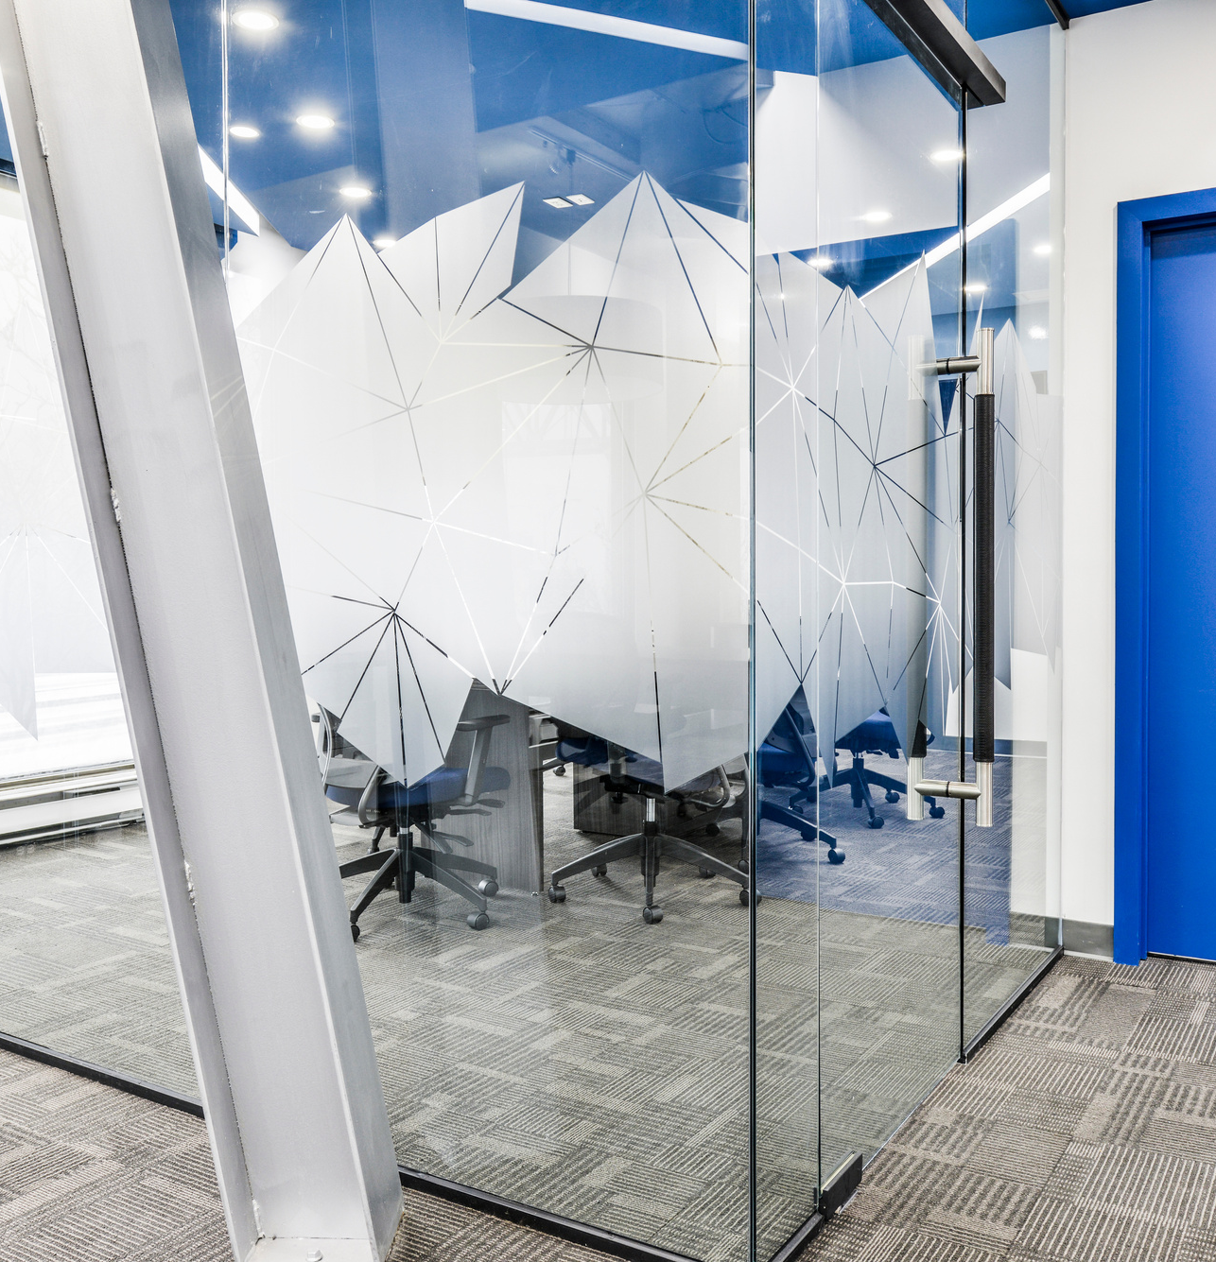
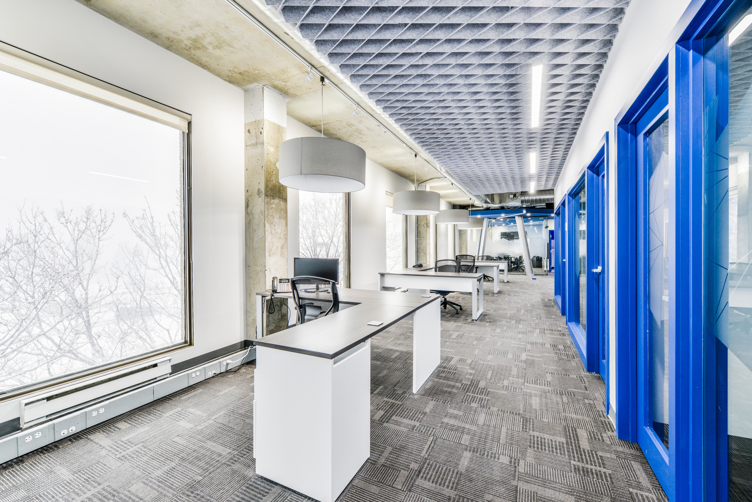
CASE STUDY
Atelier Lux Design collaborated with an engineering firm to transform its office into a modern, acoustically optimized space that improved both functionality and branding.

Slide 12
PROJECT OVERVIEW
Challenges:
Solutions:
Results:
Open-concept, noise distractions and the need for clearly defined zones.
Custom acoustic partitions, sound-masking systems, and branded design elements such as wall murals and ergonomic furniture.
A 40% reduction in noise complaints, improved collaboration, and enhanced employee satisfaction.

Slide 13
OUR APPROACH
We began by analyzing the firm’s work environment, identifying noise hotspots, and mapping their team’s workflow. Our design prioritized:
Zoning:
01
Separate quiet zones for focused tasks and collaborative areas for teamwork.
Materials:
02
Incorporating sound-absorbing materials such as acoustic panels, carpets, and specialized ceiling treatments.
Layout Optimization:
03
Efficient space planning to ensure ergonomic workstations and seamless movement between spaces.

Slide 14
KEY CHALLENGE
One challenge was minimizing noise transfer in an open-concept space. We introduced custom partitions with integrated acoustic properties and strategically placed sound-masking systems to reduce distractions.
RESULTS
The revamped office boosted employee satisfaction and productivity:
40% reduction in noise complaints (based on post-occupancy feedback).
Improved team collaboration with clearly defined spaces.
The client praised the blend of aesthetics and functionality, noting the positive impact on their daily operations.

Slide 15
TAKE AWAYS
This project demonstrated the power of thoughtful design in creating functional and acoustically optimized workspaces. By understanding the client’s workflow and leveraging smart material choices, we delivered a space that supports both focus and teamwork.

Slide 16
ACTIONABLE RECOMMENDATIONS
Audit Your Current Workspace:
Collaborate with Experts:
Set Clear Goals:
Identify opportunities for improvement in technology, sustainability, and employee wellness.
Partner with design firms specializing in modern office trends.
Align office design strategies with your company’s values and future vision.

Slide 17
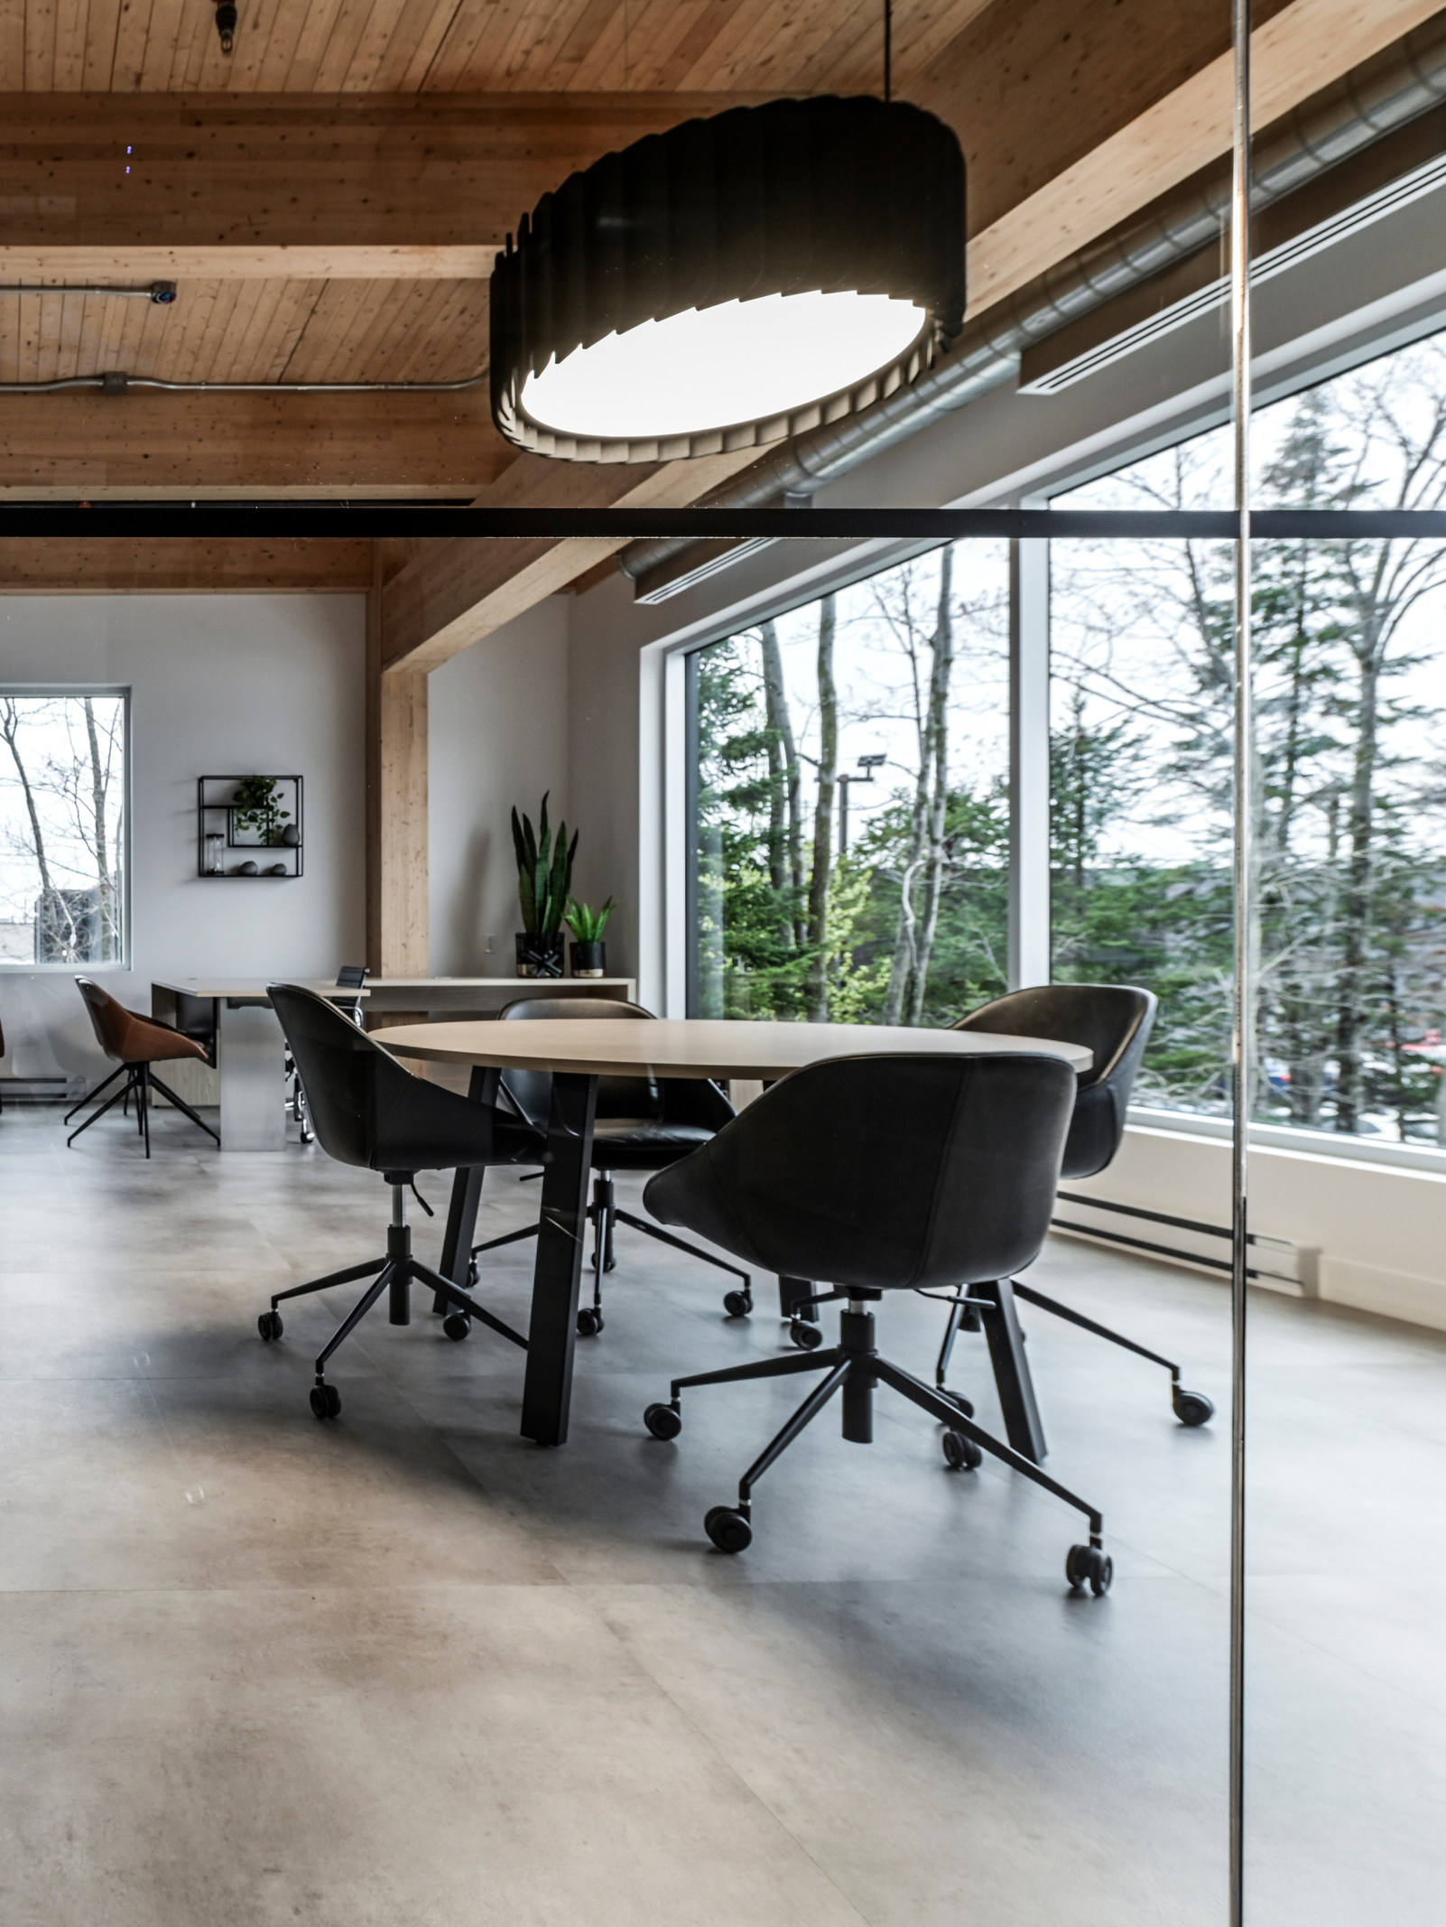
CONCLUSIONS
The 2025 office design trends emphasize adaptability, sustainability, and employee-centric features, ensuring workplaces remain relevant in a competitive business environment.
By embracing these trends, businesses can foster innovation, attract talent, and improve overall performance.

Slide 18
FIND & CONTACT
ON DETAIL BELOW
www.atelierluxdesign.com
info@atelierluxdesign.com
(514) 969-3616
893 Chemin des Patriotes Sud, Otterburn Park, Quebec J3H 2A2

